Slide 1
Traffic Sign Recognition
Anshul Bhardwaj

Slide 2
Problem Statement
Automated Traffic Sign recognition is an important part of self-driving vehicles.
Traffic Signs can provide range of variations between classes in terms of colors and shape.
In this project, I develop Deep Learning algorithms that will train on German Traffic Signs image dataset and them use these algorithms to classify unlabeled Traffic Signs images. The deep learning models will be built using Convolutional Neural Network and Transfer Learning.

Slide 3
Clients / Intended Audience
This model can be used by anyone who wants to what makes an automated self driving system.

Slide 4
Dataset
The dataset used for this project is taken from Kaggle
https://www.kaggle.com/meowmeowmeowmeowmeow/gtsrb-german-traffic-sign
The dataset contains around 4oooo train images and 12000 test images. Metadata is also provided.

Slide 5
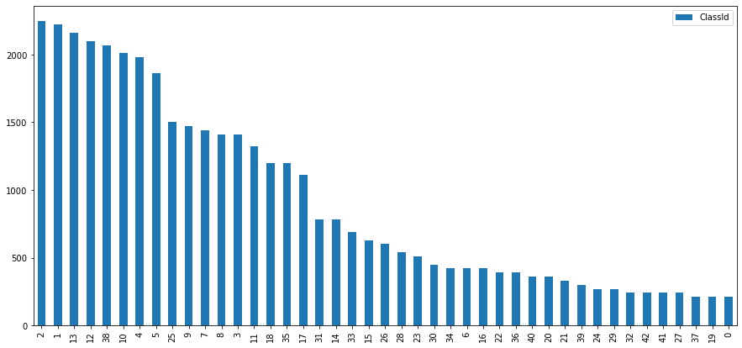
Exploratory Data Analysis
Distribution of Classes
Image : ClassId vs Frequency
This barplot depicts ClassIds and their respective frequency in image dataset.
Images with ClassIds 2, 1, 13 etc. had the highest frequency (>2000)
Images with ClassIds 37, 19, 0 etc. had the least frequency (~=200)

Slide 6
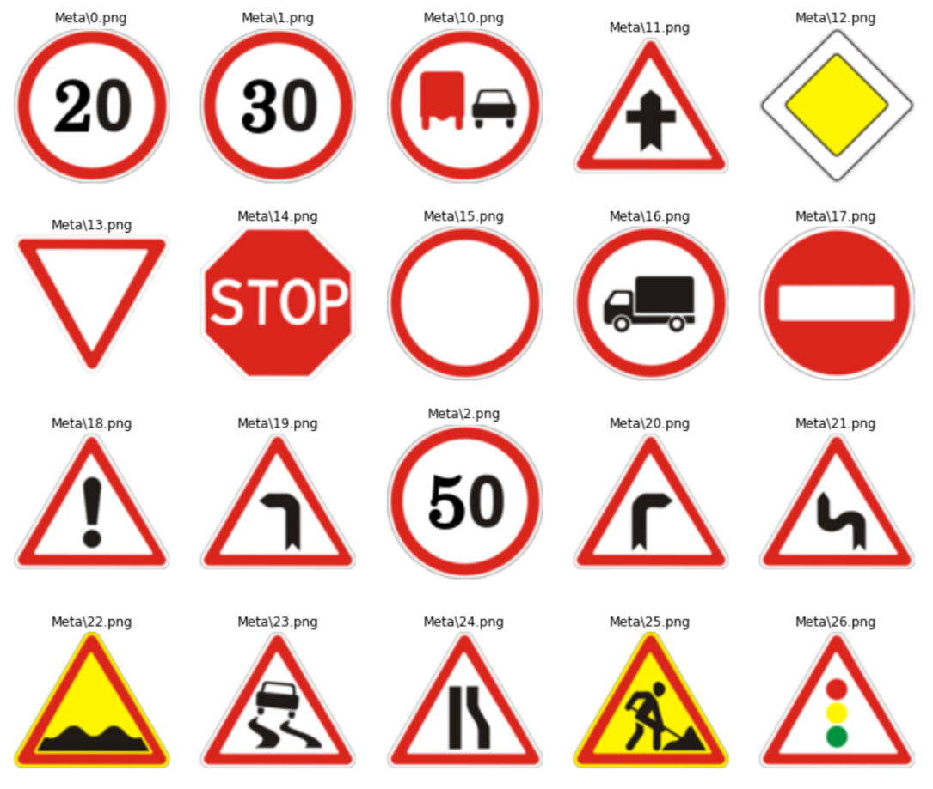
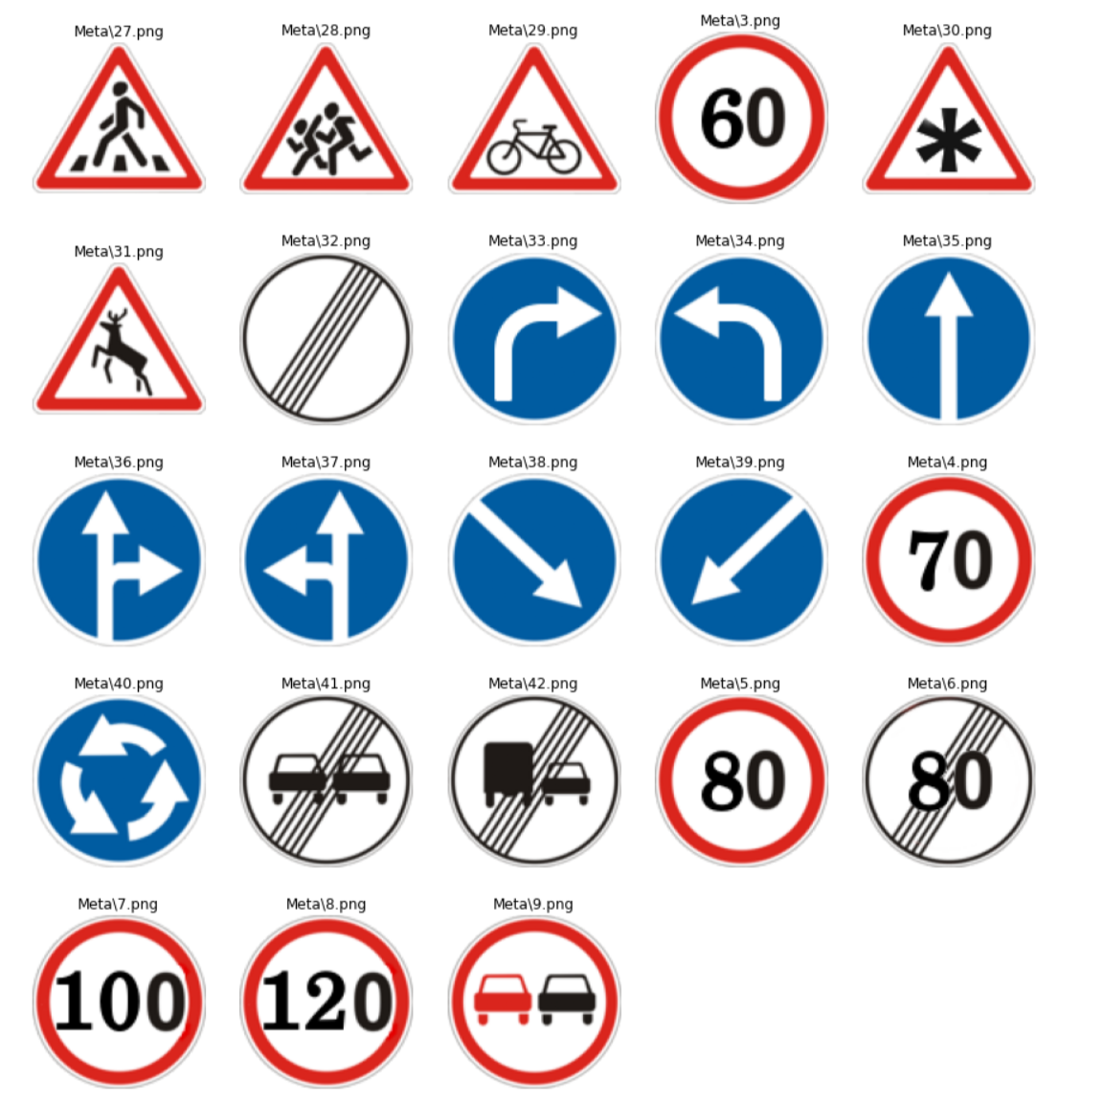
Meta
Images
Images : Meta Images of 43 Image Classes of Input dataset.
The above are the 43 Meta Images with their respective ClassIDs

Slide 7
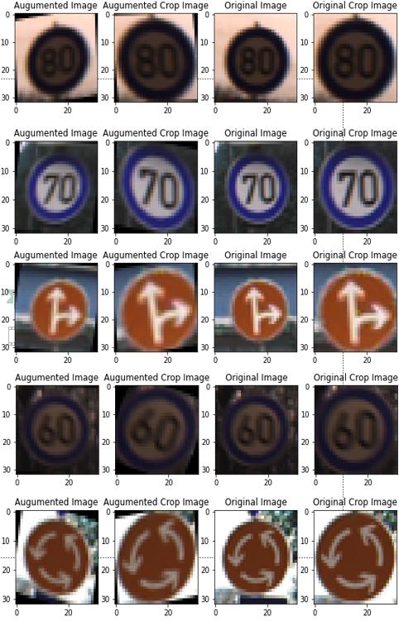
Image Augmentation
These are some of the Augmented Images and their respective Original Image
I have done two affine transformation (Rotation and Shear) on all Image to increase number of Image.
Image Augmentation also helps in generalizing the model.
Code snippet :
seq = iaa.Sequential([ iaa.Affine(
rotate=(-20, 20)
shear = (10,-10)) ])
Image : Sample Augmented Image and Original Images.

Slide 8
Training
I build three model using CNN and Transfer Learning
First model was build using Transfer Learning with ResNet50V2 Model
Second model was built using CNNs
Third model was build using Transfer Learning with VGG19 Model
Accuracy was used as metric in all three models
ADAM optimizer was used in all three models

Slide 9
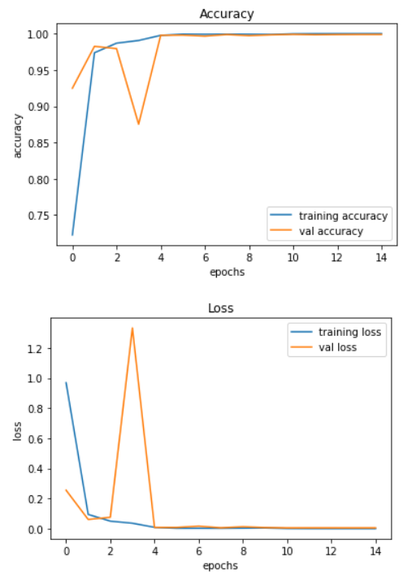
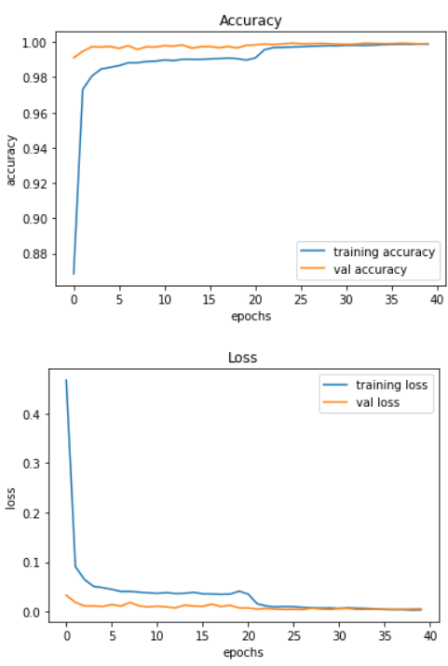
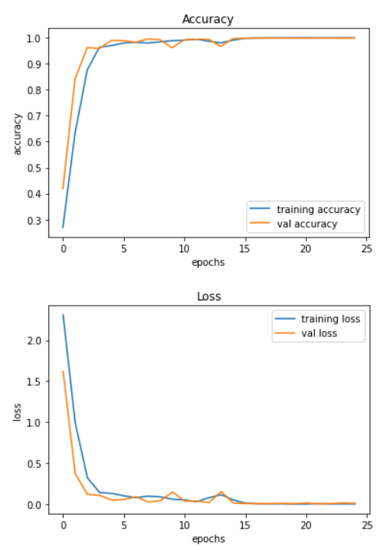
Model Performances / Histories
Image 1: ResNet50V2 Model accuracy and Loss plot
Image 2: CNN based Model accuracy and Loss plot
Image 3: VGG19 Model accuracy and Loss plot

Slide 10
Model Testing
Model accuracies for the models were as follows
Model Name | Accuracy
CNN Model | 98.72%
ResNet50V2 Model | 96.61%
VGG19 Model | 98.33%
CNN model performed the best.

Slide 11
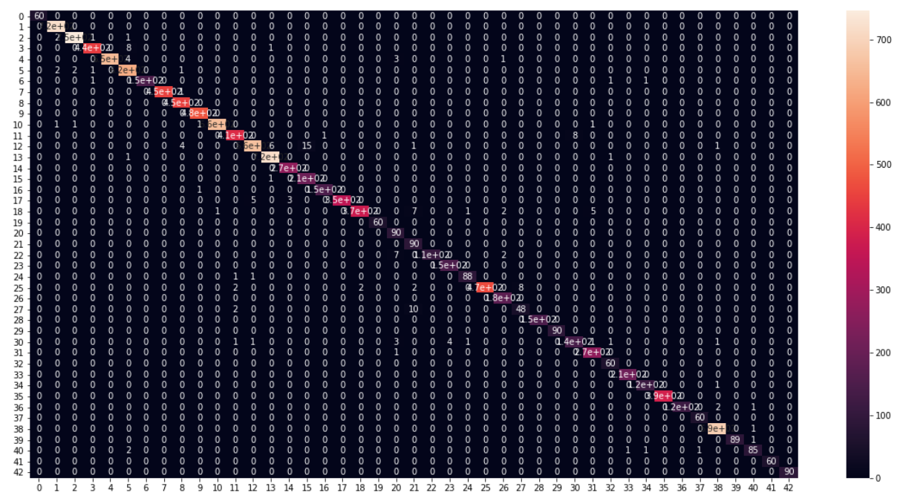
Confusion Matrix Heatmap for CNN model
Image : Confusion Matrix for CNN based Model
Important Observation :
10 Images belonging to ClassId 27 are being assigned to ClassId 21.
This CNN model’s overall performance is really good with no other significant misclassifications.

Slide 12
Ensemble of the Models
Ensembling of the models had shown the significant improvement in accuracy
Ensemble model performance were as follows –
Type of Ensemble | Accuracy
Mean Ensemble (Soft Voting) | 99.07 %
Weighted Ensemble | 99.10 %
Mode Ensemble (Hard Voting) | 98.72 %
Weighted Ensemble had shown highest accuracy.

Slide 13
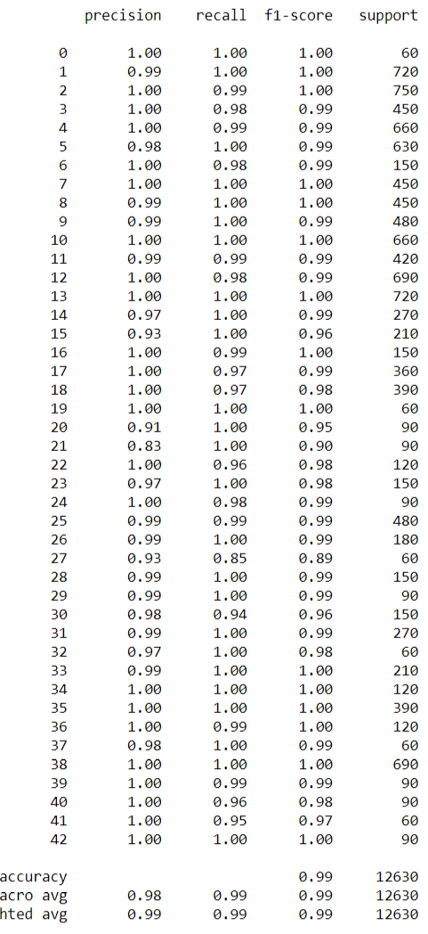
Classification Report of Weighted Ensemble
Observations –
Most of the classes has very good f1 score of 1 or 0.99
precision for Class 21 is comparatively low.
Recall for Class 27 is comparatively low.
Overall f1-score is .99
Image : Classification Report of Weighted Ensemble Model

Slide 14
Future Improvements
More Image augmentation
Class balancing through Image augmentation
Increase the input image dimension
Use More Image generators for better ram management
Make the models reproducible.

